Slide 1
BOATS & STREAMS

Slide 2
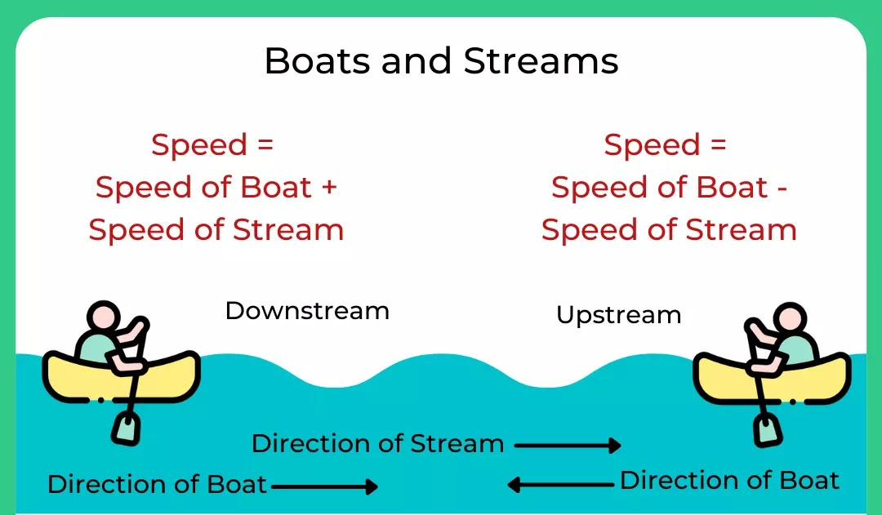

Slide 3
formulae,
D = B + W
U = B – C
B = (D + U)/2
C = (D – U)/2

Slide 4
Example:
A boatman goes 2 km against the current of the stream in 1 hour and goes 1 km along the current in 10 minutes. How long will it take to go 5 km in stationary water?
Solution:
Rate downstream = 1/10 × 60 km/h = 6 km/h
Rate upstream = 2 km/h
Speed in still water = 1/2(6 + 2) km/h = 4 km/h
Therefore, the required time for 5 km = 5/4hrs = 1 ¼ hrs = 75 min.

Slide 5
Practice Questions:
1. A boat takes a circular route to travel a total distance of 24 km to reach its initial position. The speed of the boat in still water is 5 km/hr and the speed of the stream is 3 km/h. How much time (in hrs) does the boat travel upstream and downstream respectively?
12, 3
3, 12
5, 3
3, 5

Slide 6
2. Boat goes downstream from P to Q in 2hrs, upstream in 6hrs and if speed of stream is 6km/h, then find the distance PQ
6 km
4 km
10 km
36 km

Slide 7
3. A river runs at 4 km/hr. if the time taken by a man to row is boat upstream is thrice as the time taken by him to row it downstream then find the speed of the boat in still water.
16 km/hr
8 km/hr
6 km/hr
12 km/hr

Slide 8
4. A motorboat whose speed is 15 km/h in still water goes 30 km downstream and comes back in a total of 4hrs 30min. What is the speed of the stream?
5 km/h
6 km/h
10 km/h
12 km/h

Slide 9
5. A boat sails 15 km of a river towards upstream in 5 hours. How long will it take to cover the same distance downstream, if the speed of current is one-fourth the speed of the boat in still water:
1.8 h
3 h
4 h
5 h

Slide 10
6. A man can row a certain distance against the stream in six hours. However, he would take two hours less to cover the same distance with the current. If the speed of the current is 2 Km/h, then what is the speed of the man in still water.
10 km/h
12 km/h
16 km/h
8 km/h

Slide 11
7. A man can row downstream at 12 Km/h and upstream at 8 Km/h. Find the ratio of the speed of the current to the speed of the man in still water?
1 : 5
5 : 4
25 : 16
16 : 25

Slide 12
8. In a stream running at 2 km/h, a motorboat goes 10 km upstream and returns to the starting point in 55 minutes. Find the speed (all in km/h) of the motorboat in still water.
2
11
22
None of these

Slide 13
9. The ratio of the speed of the boat in still water to the speed of the current is 4:1. What is the ratio of the downstream speed of the boat to the upstream speed?
2:1
1:1
5:3
None of these

Slide 14
10. A boatman rows to a place at a distance 45 km and comes back in 20 hours. He finds that he can row 12 km with the stream in the same time as 4 km against the stream. Find the speed of the stream.
3 km/h
2.5 km/h
4 km/h
3.5 km/h

Slide 15
11. Two boats, travelling at 5 km/h and 10 km/h respectively, head directly towards each other. They begin at a distance of 20 km from each other. How far apart are they (in km) one minute before they collide?
1/12
1/6
1/4
1/3

Slide 16
12. A man takes twice as long to row a distance against the stream as to row the same distance along the stream. The ratio of the speed of the boat (in still water) and the stream is
2:1
3:1
3:2
4:3

Slide 17
13. A man takes a total time of 2hours to cover a distance of 6 km while doing upstream and downstream. If the speed of stream is 4 km/h find speed of boat in still water?
2 km/h
6 km/h
3 km/h
8 km/h

Slide 18
14. While going A to B against the stream and coming back from B to A with stream it takes a total time of 3 hours. If the distance from B to A is 4 km and speed of stream is 1 km/h. Find speed of boat in still water?
2 km/h
4 km/h
3 km/h
1 km/h

Slide 19
Advance Questions

Slide 20
15. Ratio of Speed of boat to the speed of current of water is 36:5. The boat goes along with the current in 5 hours 10 minutes. It will come back in ?

Slide 21
16. A boat covers 25 km upstream and 39 km downstream in 8 hours. While it covers 35 km upstream and 52 km downstream in 11 hours. Find speed of current. ?

